Slide 1
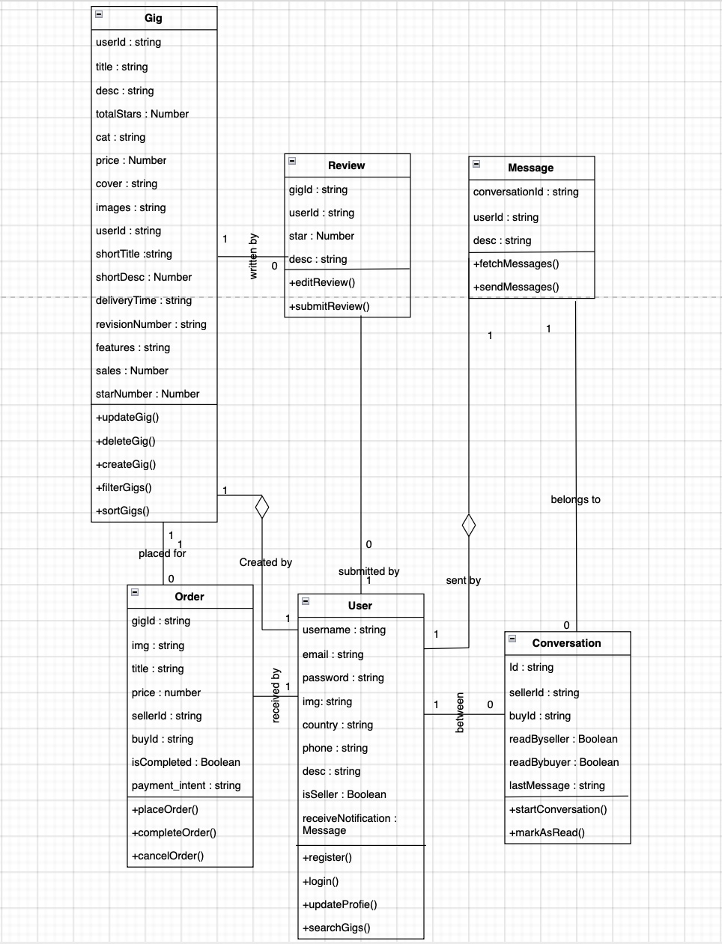
Class Diagram
Application: Freelance Forge

